Slide 1

Sajid Khan

Slide 2
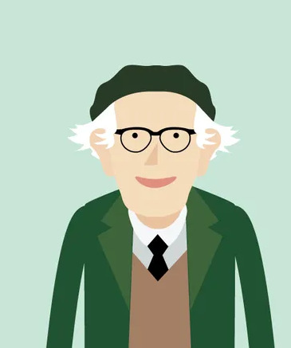
Piaget (1896 - 1980)
Swiss Psychologist,
Worked for several decades on understanding children’s cognitive development
Most widely known theory of cognitive development.
He was intrigued by kids’ thoughts & behavior, and worked to understand their cognitive development
.

Slide 3
Piaget: Background
Young Piaget was incredibly precocious
Published first paper at 10
Wrote on mollusks, based on these writings was asked to be curator of mollusks at a museum in Geneva (he declined in order to finish secondary school)
Earned his doctorate in natural sciences at 21
Began to study psychology, applying intelligence tests to school children

Slide 4
Piaget & Learning
Two main states – equilibrium & disequilibrium
Believed that we are driven or motivated to learn when we are in disequilibrium
We want to understand things
Equilibration: assimilation & accommodation
We adjust our ideas to make sense of reality
Assimilation:
process of matching external reality to an existing cognitive structure.
Accommodation:
When there’s an inconsistency between the learner’s cognitive structure & the thing being learned the child will reorganize her thoughts

Slide 5
Learning & Education
Not interested in applying his theory to school-based education, he called this “The American question”
Constructivist educators create an environment which encourages children to construct their own knowledge.
But according to Piaget, we construct our learning regardless of how it is presented.
.

Slide 6
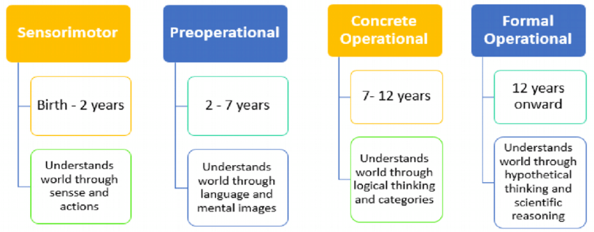
Stages of Cognitive Development
A child’s capacity to understand certain concepts is based on the child’s developmental stage. He believed that all children develop according to four stages based on how they see the world. He thought the age may vary some, but that we all go through the stages in the same order.

Slide 7
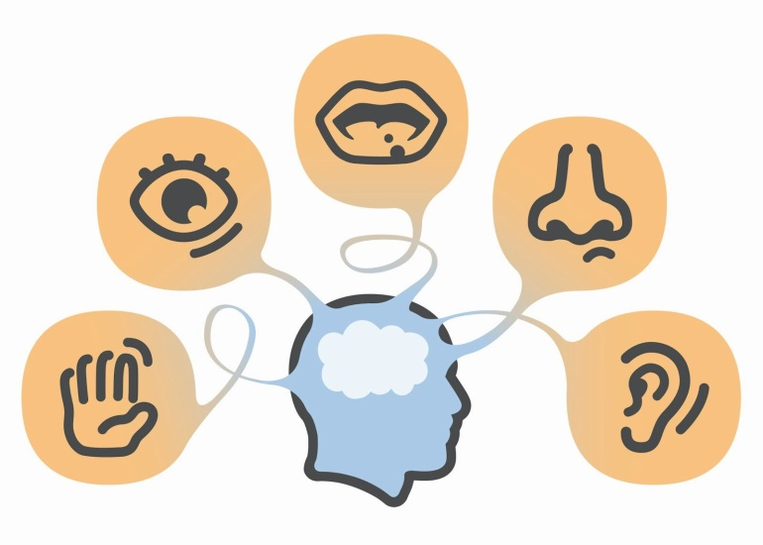
Sensorimotor Stage
Birth to about 2 years, rapid change is seen throughout
The child will:
Explore the world through senses & motor activity
Early on, baby can’t tell difference between themselves & the environment
If they can’t see something then it doesn’t exist
Begin to understand cause & effect
Can later follow something with their eyes

Slide 8
Preoperational Stage
About 2 to about 7
Better speech communication
Can imagine the future & reflect on the past
Develop basic numerical abilities
Still pretty egocentric, but learning to be able to delay gratification
Can’t understand conservation of matter
Has difficulty distinguishing fantasy from reality (ex: cartoon characters are real people).
Conservation of matter – understanding that something doesn’t change even though it looks different, shape is not related to quantity
Ex: Are ten coins set in a long line more than ten coins in a pile?
Ex: Is there less water if it is poured into a bigger container?

Slide 9
Concrete Operational Stage
From about 7 to about 11
Abstract reasoning ability & ability to generalize from the concrete increases
Understands conservation of matter
Can understand classes and sub-classes
Ex: Animals and dogs

Slide 10
Formal Operations
From about 12 to about 15
Be able to think about hypothetical situations
Form & test hypotheses
Organize information
Reason scientifically

Slide 11
… Piaget’s Development
Development happens from one stage to another through interaction with the environment.
Changes from stage to stage may occur abruptly and kids will differ in how long they are in each stage.
Cognitive development can only happen after genetically controlled biological growth occurs
Development leads to learning
Drive for development is internal
The child can only learn certain things when she is at the right developmental stage
Environmental factors can influence but not direct development
Development will happen naturally through regular interaction with social environment

Slide 12
Piaget & Education
Piaget did not think it was possible to hurry along or skip stages through education
Regardless, many American schools will try to teach to the stages in an attempt to accelerate development

Slide 13
Problems with Piaget’s Theory
Children often grasp ideas earlier than what Piaget found
Cognitive development across domains is inconsistent (e.g. better at reading than math)
Studies have shown that development can to some degree be accelerated

Slide 14
Cooley and the Looking Glass Self
Self-concept: an image of yourself as having an identity separate from other people
Cooley developed this idea by watching his own children at play
Children learn to judge themselves based on how they imagine others will react to them
Other people serve as a mirror for the development of self
Looking-glass self: a self concept based
on what you believe others think of you

Slide 15
The Looking-Glass Self
According to Cooley, the looking-glass self is a 3 step process that constantly takes place
1. We imagine how we appear to others
(our perception of how others see us)
2. We imagine the reaction of others to our
(imagined) appearance
3. We evaluate ourselves according to how we imagine others have judged us
This process is not a conscious process and the stages can occur quickly. The results can be positive or negative self-evaluation

Slide 16
A Distorted Glass?
Because the looking glass comes from
our imagination, it can be distorted
The mirror may not accurately reflect other’s opinion of us
Unfortunately, regardless of whether or not we are correct or incorrect about their perception the consequences are just as real as if it were
“I don’t think they liked me; therefore they don’t like me”

Slide 17
Who is your most important mirror?
According to Mead, some people who are more important to us than others
Significant Others: People whose judgments are most important to our self-concept
Depending on your age your significant others can change
Children: parents, grandparents, siblings
Teenagers: peers
Adults: spouses, parents, friends, and employers

Slide 18
What is Role Taking?
Role Taking: assuming the viewpoint of someone else and using that viewpoint to shape self-concept
Allows us to see ourselves through the eyes of someone else; allows you to imagine in your mind what someone might say or do
How could you use role taking to ask for your parent’s new car keys?

Slide 19
Mead’s 3 Stages of Role Taking
1. Imitation Stage (1½-2 years): children imitate the physical & verbal behavior of significant others without understanding.
2. Play Stage (3-4 years): play involves acting and thinking as a another person would. The child imagines the world through another’s eyes and assume one role at a time.
3. Game Stage (4+ years) many roles are considered at once, they anticipate others actions, and there are specific rules (norms of the group are important) The players know who is supposed to be doing what.

Slide 20
Acting on Principle
During the game stage, a child’s self-concept, attitudes, beliefs and values come to depend less on individuals and more on general concepts
Being on time is more than just a matter of pleasing the person you are meeting; it is a matter of principle to be on time
Generalized Other: an integrated concept of norms, values, & beliefs of one’s society

Slide 21
Mead’s Concept of Self= 2 Parts
The “me”
-part of self created through socialization
-predictability and conformity come from the “me”
The “I”
-part of self that is spontaneous, unpredictable, & creative
-acts in extreme situations of rage to excitement
but also …
“I” and “Me” constantly interact in social situations …

Slide 22
Who’s in charge?
The first reaction comes from the “I”
BUT before we act, the response is channeled through the socialized “me”
Typically, the “I” takes the “Me” into account (thinks about consequences)
BUT, humans are NOT always predictable
Therefore, the “me” is NOT always in charge!

Slide 23
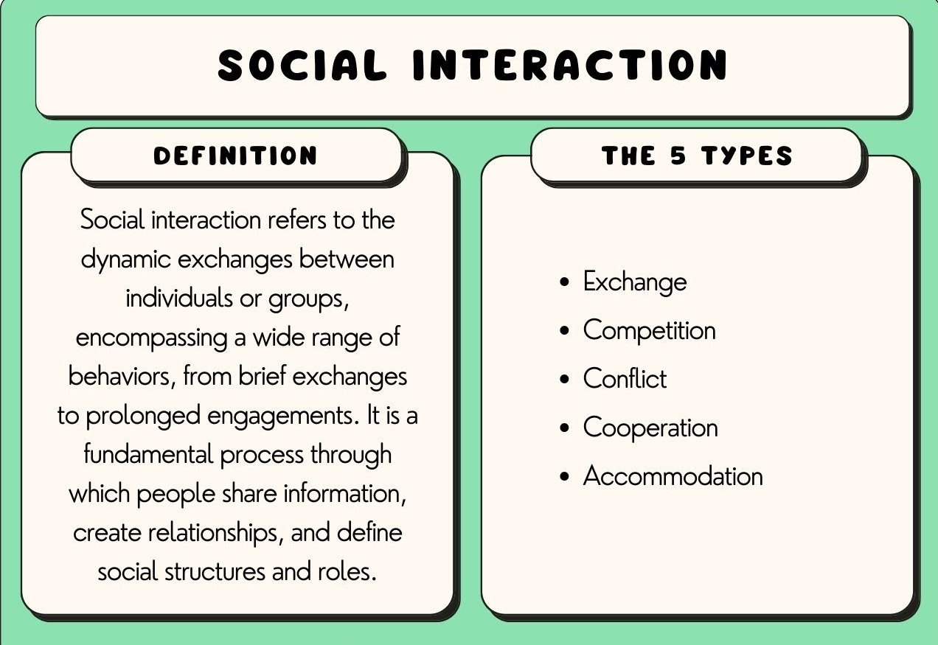

Slide 24
Social Process
Social processes refer to forms of social interaction that occur repeatedly. By social processes we mean those ways in which individuals and groups interact and establish social relationships. There are various of forms of social interaction such as cooperation, conflict, competition and accommodation.
Cooperation: Collaborative efforts where individuals or groups work together to achieve common goals. Example: Teamwork in a workplace to complete a project.
Conflict: A social process where individuals or groups struggle against each other due to opposing interests or views. Example: Disputes between neighboring countries over territory.
Competition: A social process where individuals or groups vie against each other for resources, status, or recognition. Example: Businesses competing in a market to attract customers.
Accommodation: The process of adjustment between conflicting groups or individuals to maintain harmony. Example: Compromises made between political parties to pass legislation.

Slide 25
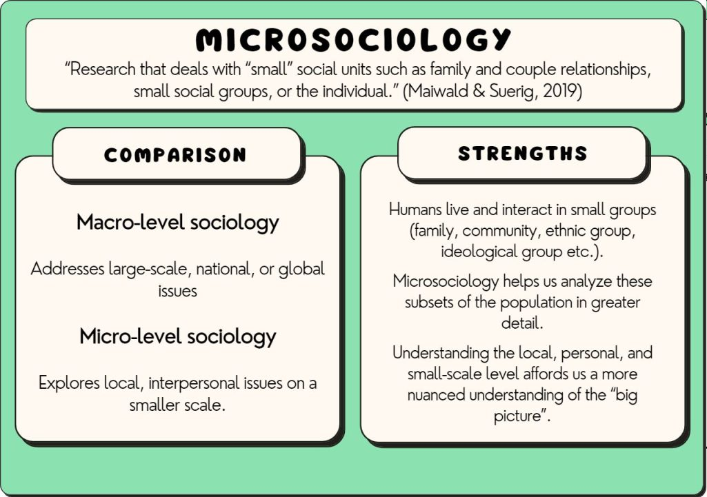

Slide 26
Micro Sociology vs. Macro-sociology
Sociology itself is the systematic study of human society, focusing on its structures, dynamics, and the relationships that connect individuals within social contexts. It aims to understand human behavior at both individual and collective levels, while examining the social forces and institutions that shape our lives. Micro-sociology and macro-sociology are two branches of sociology.
Micro sociology is a subfield of sociology that focuses on the study of small-scale social interactions and the ways in which individuals and small groups shape society through their everyday actions. Unlike macro-sociology, which looks at large-scale social structures and institutions, micro-sociology focuses on the nuances of face-to-face interactions, communication, and behaviors within specific social settings.

Slide 27
Key Concepts in Micro-Sociology
Symbolic Interactionism
Individuals create meaning through symbols (e.g., words, gestures). Example: A smile may symbolize friendliness or sarcasm depending on the context.
Role Theory
Focuses on how individuals enact roles based on social expectations. Example: A teacher instructs, maintains order, and assesses performance in the classroom.
Dramaturgical Theory
Social interactions are likened to theatrical performances (Erving Goffman). Example: A job interview is a "front-stage" performance; nervousness is kept "backstage.“
Face-to-Face Interaction
Examines in-person interactions in everyday settings. Example: Analyzing customer-cashier interactions to understand social norms.

Slide 28
Key Concepts in Micro-Sociology
Ethnomethodology
Studies how people make sense of their social world through everyday reasoning. Example: Unwritten rules in an elevator, like maintaining personal space.
Conversation Analysis
Analyzes spoken discourse to uncover patterns in communication. Example: Investigating turn-taking and interruptions in dialogue.
Small Groups
Explores dynamics within small groups like families or work teams. Example: Studying a family dinner conversation to understand roles and communication.

Slide 29
